Slide 1
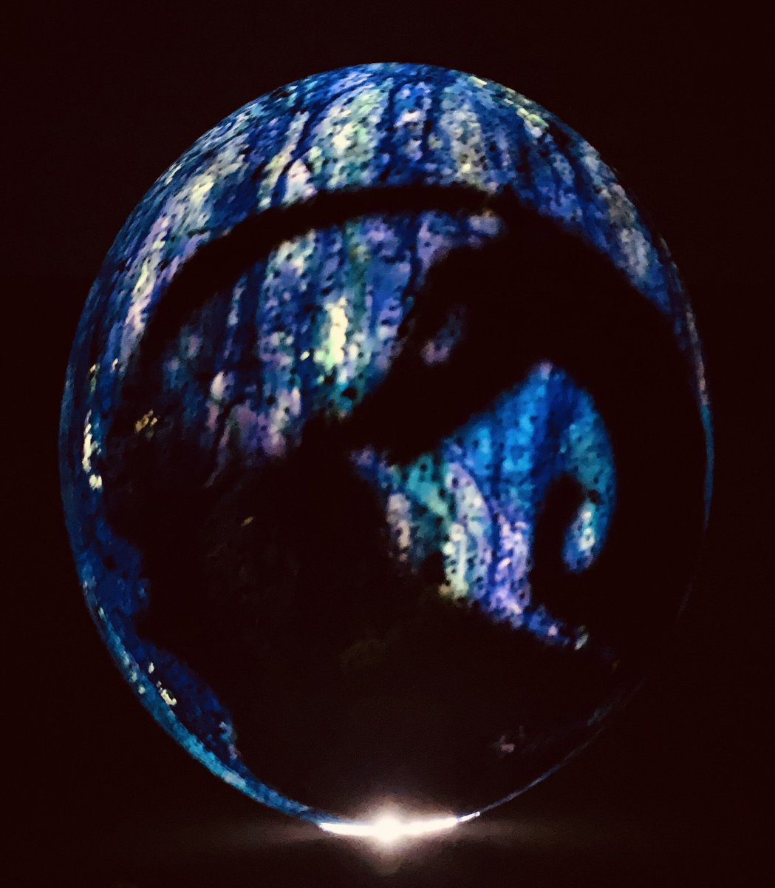
Hatching Dragons

Slide 2
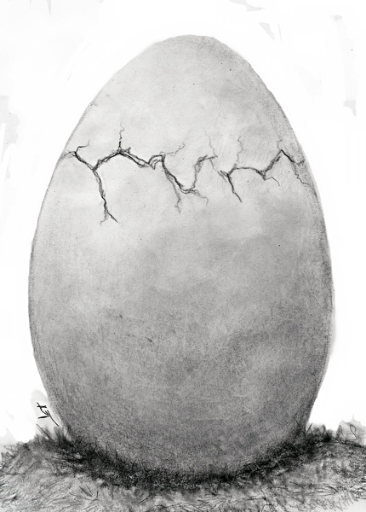
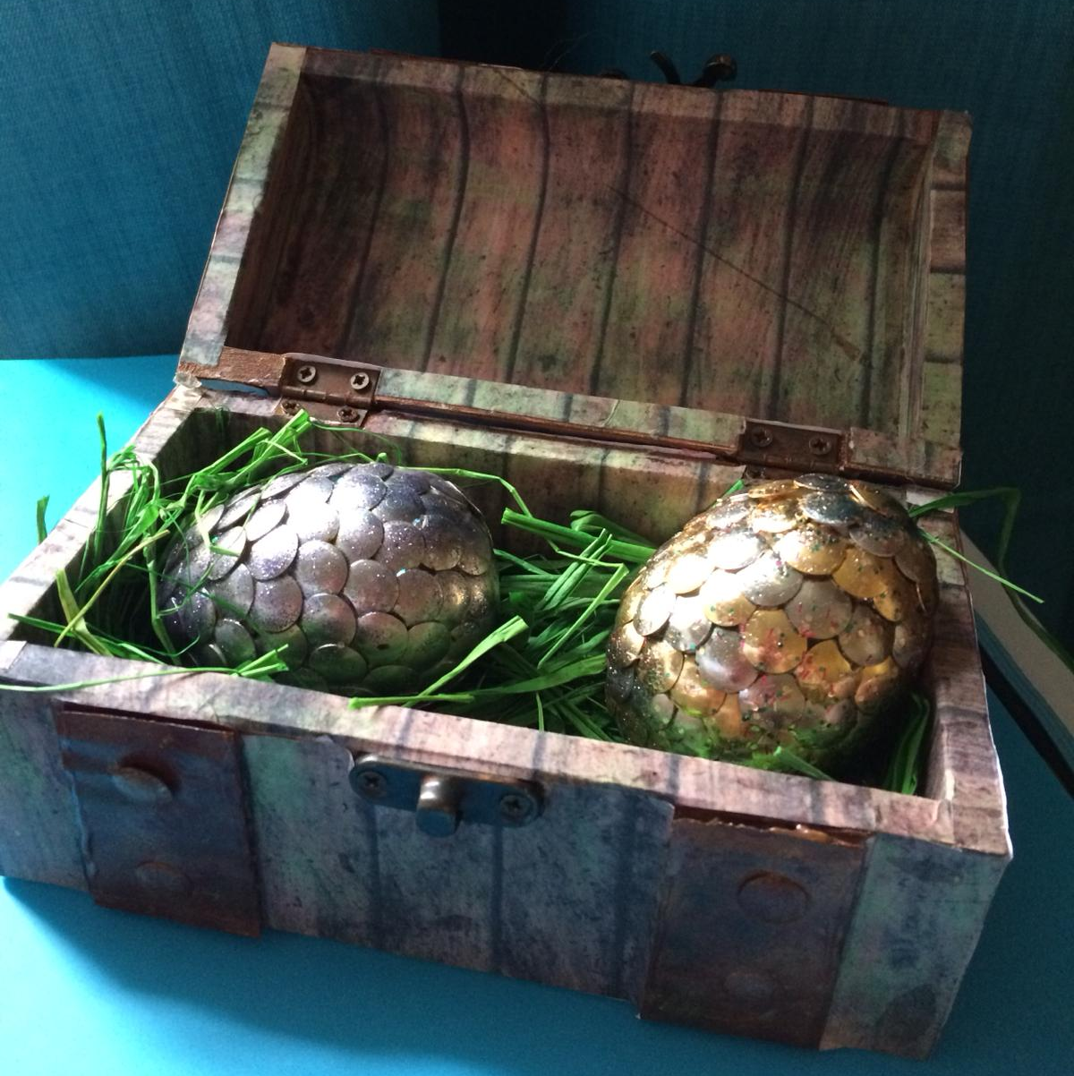
Your dragon is beginning to hatch!
How did Milla feel when this happened to her?
What did the process look like?
What were the stages?
What did the baby dragon look like?

Slide 3
Listen and read chapter 16 page 119 -123
Jot down phrases which describe the hatching of the dragon.
Which ones are your favourite?

Slide 4
Here are some of the phrases:
Crkk! A tiny nobbled lump appeared, right through the egg, pushing out a jagged piece of shell the size of her thumbnail.
The dragon made steady progress, with pauses to rest. Tsk! Another large piece fell off.
Then came a different movement: a rocking, shifting, gathering. Quite suddenly, the two halves of the shell fell apart.
Curled on the cushion lay a damp, exhausted baby dragon, mewing faintly, next to the shards of its shell. Its body glistened with moisture, dark blue like lapis lazuli.
This time the dragon staggered forwards, tripping over its tail. Then it got up, flicking its tail behind it, ridged with tiny blue bumps all along its length. It stood taller and stared at Milla through two unblinking eyes, fixed on her: two green jewels, each slashed vertically with a black iris.

Slide 5
How did Milla feel?
Which words and phrases tell you Milla’s emotions as the dragon hatches?

Slide 6
She had to be there. Milla felt it like a fire in her blood.
‘A dragon!’ Milla’s heart blossomed at the sight. The colour of the dragon unlocked something inside her: she recognised that blue. It was the blue from her dreams. This was meant to be.
Milla and the dragon stared at each other and the world was remade.
She felt as if the dragon saw right into her soul; and her soul gazed back. She knew without a shadow of a doubt that the dragon was hers. She loved it. She would live and die for it.

Slide 7
Imagine your dragon is hatching…
‘This is meant to be.’
Drama Freeze Frame!
Create 2 scenes.
The first scene you are watching the egg begin to crack. What happens?
The second scene the dragon is out! What does it look like?
When your teacher taps you on your shoulder, you will say your thoughts and emotions at the scenes.

Slide 8
Watch some clips of birds hatching and baby foals walking for the first time.
Use a thesaurus to help you.
What powerful vocabulary can you use to describe these young, fragile wobbly creatures?

Slide 9
Use the planning template to jot down your vocabulary choices.
Description | My emotions
Hatching Crkk! A tiny nobbled lump appeared, right through the egg, pushing out a jagged piece of shell the size of her thumbnail. | I had to be there. I felt it like a fire in my blood.
Dragon Curled on the cushion lay a damp, exhausted baby dragon, mewing faintly, next to the shards of its shell. Its body glistened with moisture, dark blue like lapis lazuli. | We stared at each other and the world was remade.

Slide 10
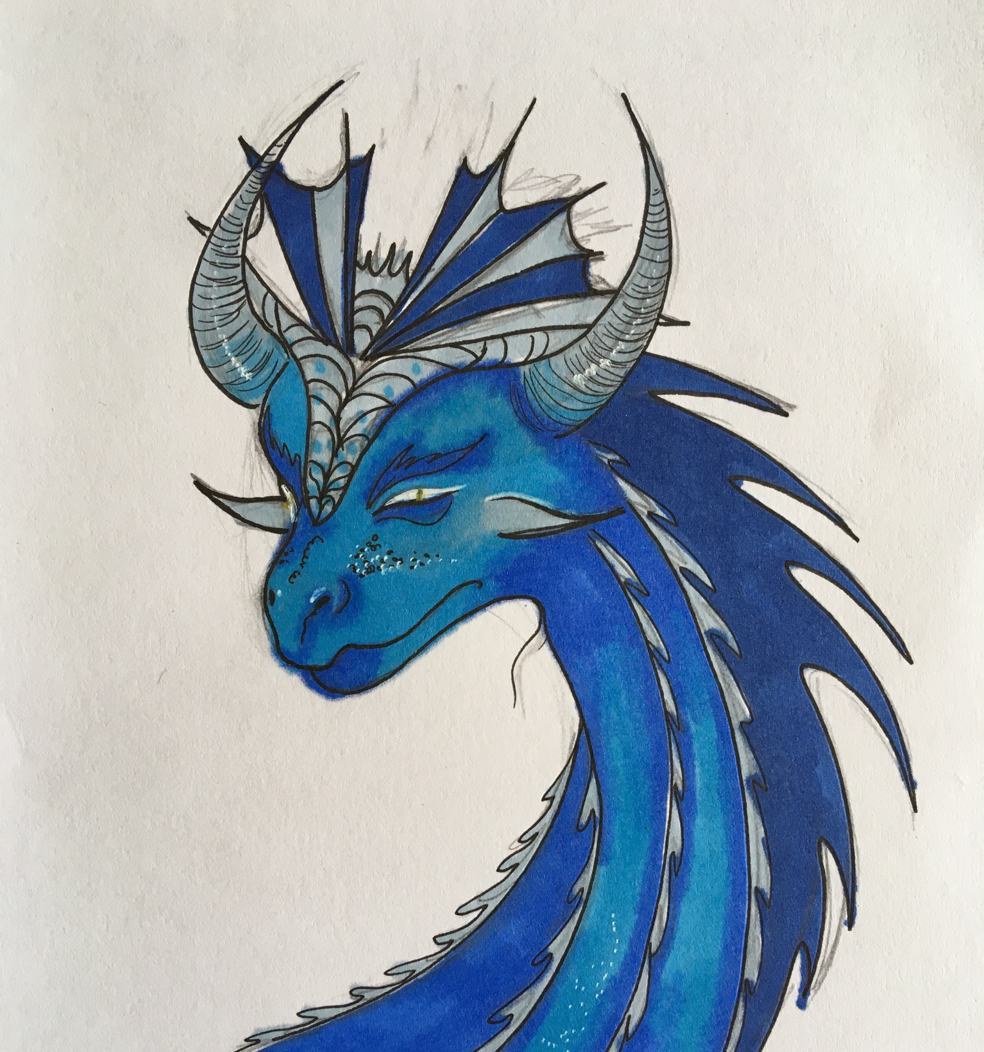
Now, write a description of your hatching dragon. Dragon artwork by Molly Hill.

